Slide 1
CryptDB
Guaranteed confidentiality with encrypted query processing

Slide 2
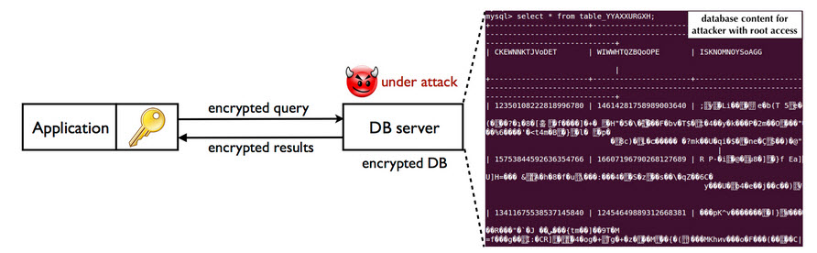
CryptDB
http://css.csail.mit.edu/cryptdb

Slide 3
Why do we need such system?
Many possible reasons…
In a database system, administrator may capture or leak data…
Online applications are vulnerable to theft of information.
Encryption schemes help in guaranteeing these:
C: Confidentiality
I: Integrity
A: Authentication

Slide 4
An example…
Encrypt(a)
Encrypt(b)
Encrypted(a+b)

Slide 5
CryptDB - Introduction
Provides practical and provable confidentiality in many ways.
It work by executing SQL queries over encrypted data.
It uses a collection of SQL-aware encryption schemes.
It chains encryption keys to user passwords.

Slide 6
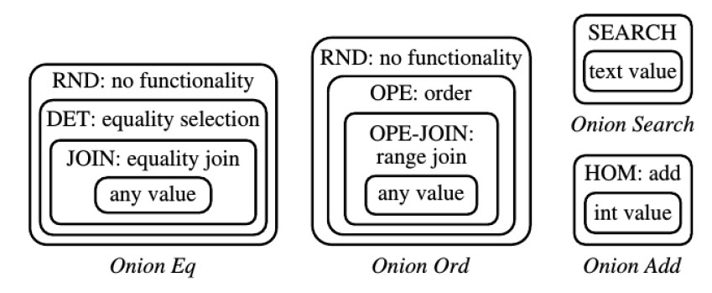
Onion Layers

Slide 7
Onion Layers
Each query needs certain operations to be processed.
Group By: needs equality checking…
Sum: Performing addition over encrypted data…

Slide 8
Onion Layers
An onion features different layers of encryption from least revealing on the outside to most revealing on the inside.
“Peeling a layer” occurs automatically when the need arises.

Slide 9
Encryption Types - RND
Provides the strongest security assurances.
It is probabilistic, meaning that the same plaintext, will be encrypted to a different ciphertext.
Problem: It does not allow any feasible computation in a reasonable amount of time.

Slide 10
Encryption Types - HOM
It is specifically designed for columns of the data type integer and allows the database to perform operations of an additive nature.

Slide 11
Encryption Types - SEARCH
This layer is exclusive for columns of the data type “text”.
Allows for a keyword level text search with the LIKE operator.

Slide 12
Encryption Types - DET
The second strongest security assurance.
It is deterministic.
This helps with queries like “Group By”…

Slide 13
Encryption Types - OPE
OPE (Order-preserving encryption)
Using that, if x is less than y, then OPE(x) is less than OPE(y).
This one helps with ordered operations like MIN, MAX, ORDER BY.

Slide 14
Encryption Types – JOIN, OPE-JOIN
It’s like OPE and DET, and helps us with queries concerning the JOIN operation…

Slide 15
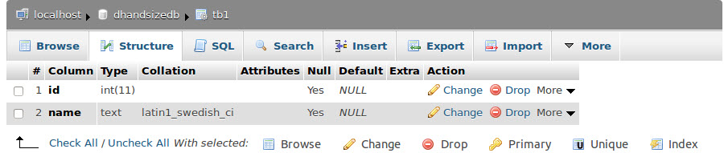
Example

Slide 16
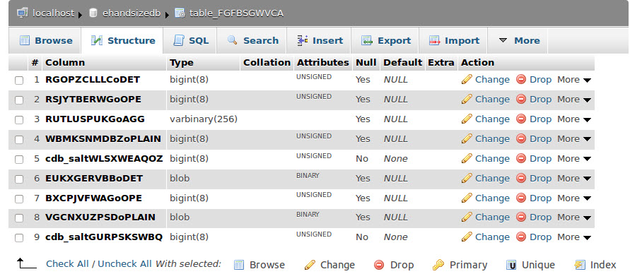
Example

Slide 17

Example

Slide 18
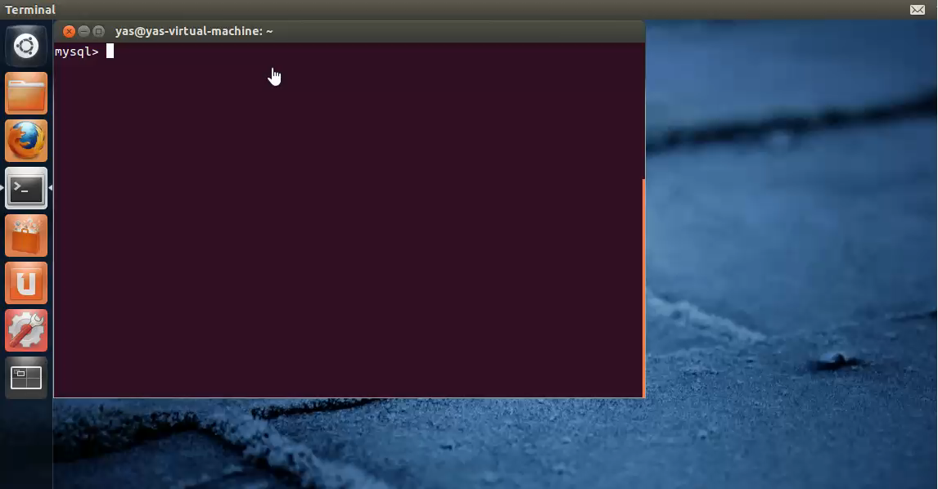
Example – Running CryptDB

Slide 19
Impact
Google BigQuery
IaaS (Infrastracture as a service)
BigQuery is Google's fully managed, petabyte scale, low cost analytics data warehouse.
Google has now developed an experimental version of it, called Google’s Encrypted BigQuery, which is inspired by the way cryptdb operates.

Slide 20
Impact
Microsoft's Always Encrypted SQL Server
Before this service, the database in the SQL Server was in plaintext during processing.
The authors of Microsoft's Cipherbase system led this effort; Cipherbase is a successor of CryptDB which enhances CryptDB with trusted hardware support for queries not supported on encryption.

Slide 21
Impact
Lincoln Labs
Lincoln Labs added the CryptDB design on top of their D4M Accumulo no-SQL engine.

Slide 22
CryptDB - Introduction
Server
Client
Proxy

Slide 23
Threats
Consider a situation in which the DBA is the adversary, and tries to learn the private data (e.g., financial statements, personal information).
An adversary gains complete control of application and DBMS servers.

Slide 24
CryptDB shows up…
SQL-aware encryption strategy
Adjustable query-based encryption
Chain encryption keys to user passwords

Slide 25
CryptDB
It does not hide the overall table structure, the number of rows and the types of columns or the approximate size of data in bytes.
The security of CryptDB is NOT perfect, it reveals to the DBMS server “relationships” among data items that correspond to the classes of computation that queries perform on the database.
This way it can take care of things like performing word search, checking equality, and sorting.

Slide 26
Queries…
CryptDB supports a subset of SQL queries…
Example: Select * from t where x+10<20
Another possible reason could be a bug in codes, that will lead to crash.
Another example would be a subset of queries which include regular expressions.

Slide 27
Measuring the performance…
This tests will be performed using benchmarks like TPC-C.

Slide 28
TPC-C
TPC (Transaction Processing Performance Council)
TPC-C is different and more complex than TPC-A because of its multiple transaction types, more complex database, and overall execution structure.

Slide 29
TPC-C
The goal of TPC benchmarks is to define a set of functional requirements that can be run on any transaction processing system, regardless of hardware or operating system.

Slide 30
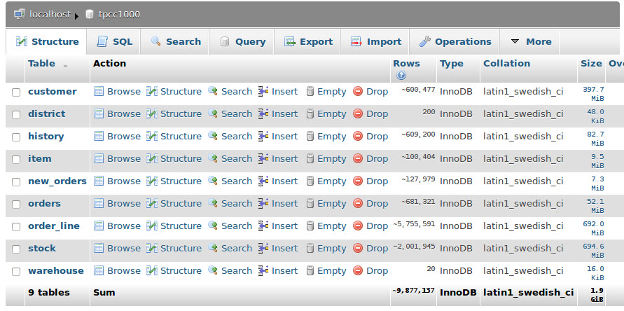
TPC-C

Slide 31
Measuring the performance…
On a machine with two 2.4 GHz Intel Xeon E5620 4-core processors and 12GB of RAM to run the MySQL 5.1.54 server, and a machine with eight 2.4 GHz AMD Opteron 8431 6-core processors and 64GB of RAM to run the CryptDB proxy and the clients.

Slide 32
Results
Query | MySQL | Server | Proxy | Proxy*
Select by = | 0.10 | 0.11 | 0.86 | 0.86
Select join | 0.10 | 0.11 | 0.75 | 0.75
Select range | 0.16 | 0.22 | 0.78 | 28.7
Select sum | 0.11 | 0.46 | 0.99 | 0.99
Delete | 0.07 | 0.08 | 0.28 | 0.28
Insert | 0.08 | 0.10 | 0.37 | 16.3
Update set | 0.11 | 0.14 | 0.36 | 3.80
Update inc | 0.10 | 0.17 | 0.30 | 25.1
Overall | 0.10 | 0.12 | 0.60 | 10.7

Slide 33
To sum up…
An analysis of a trace of 126 million SQL queries from a production MySQL server shows that CryptDB can support operations over encrypted data for 99.5% of the 128,840 columns seen in the trace.
CryptDB has low overhead, reducing throughput by 14.5% for phpBB, and by 26% for TPC-C, compared to unmodified MySQL.

